Slide 1
ASTRAS E-procurement – Onboarding manual for suppliers
Supplier manual for self-registration to ASTRAS
Digitalization, Systems & Data Analytics

Slide 2
Agenda
Introduction
Onboarding Process
General Information
Self-Registration
Personal Data
Company Information (Address, Information)
Details Production Plant
Details Development / Construction
Details Quality Management
Details Logistics
Further Certificates
4
5
6
7
7
8 - 10
11
11
12
13
14

Slide 3
Agenda
Data Handling
Contracts
Material Groups
Production Plant
Region
Certificates
Documents
Contact Persons
NDAs
General Terms of Use
Finish Registration
15
16 – 17
18
19
20
21 – 22
23
24 – 25
26
27
28

Slide 4
Introduction
Dear Sir or Madam,
We are glad to invite you to our current supplier management system, ASTRAS.
The aspects described here play an important role for Grammer. Therefore, we ask you to read this manual conscientiously and accurately and to heed when completing your self-registration.
Thank you and best regards,
Supply Chain Management Group

Slide 5
Onboarding Process
Start your self-registration
Your Purchasing contact will get a registration link sent to your email address.
Access the link and fill out all the required company information. (Save your password!)
Click “Finish Registration”
Wait for approval
You´ll receive an email confirming the completed registration and advising to wait for the next step.
Our quality and management department will internally check and approve your registration.
We kindly ask you to wait while approvals are done.
Internal approvals done
An email confirming your access to the system will be sent to you! Contents:
Link to our portal,
A “first look” ppt. so the navigation is easier for you,
Your personal username (the password will be the one you created during registration).
Your company, quoting & contractual data is secured through your direct interaction with the system!
Follow up easily on your supplier ratings and action plans!
Be considered to our new projects which are quoted solely through ASTRAS!
Welcome on board!

Slide 6
General information
We would like to point out that all the information you provide during self-registration is legally binding.
Please make sure that you fill in all fields accurately, carefully and correctly (mandatory fields are marked in green).
Please register in German or English only.
Green fields are mandatory. If a tab is marked red, you have either forgotten a mandatory field or the entry is in the wrong format. Go back to the affected tab and insert the missing data. Only when all tabs are written in black, you can complete the registration.
Once a year you will be asked to update your data. Only after the update you will be able to enter bids again.
For better navigation we recommend you use Google Chrome.
A 30-minute countdown is integrated in the portal to protect your data. As long as you navigate in the system, the clock will restart automatically. You will find the clock in the lower right corner of the screen.
You can save temporarily your data as many times as needed and access back through a link that will be sent to you by email.

Slide 7
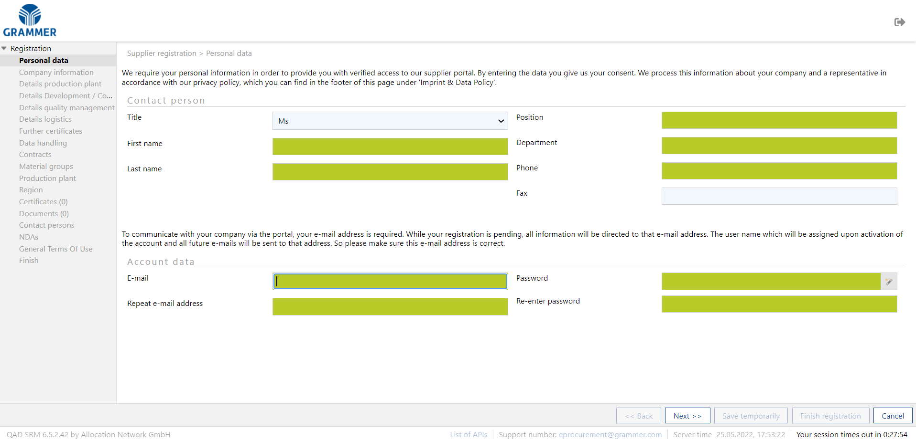
Self-Registration
Supplier Registration → Personal Data
When clicking the email Self-registration link, you will be directed to the following page:
Here you enter your personal data as contact person.
You can generate a random password.
1
Clock

Slide 8
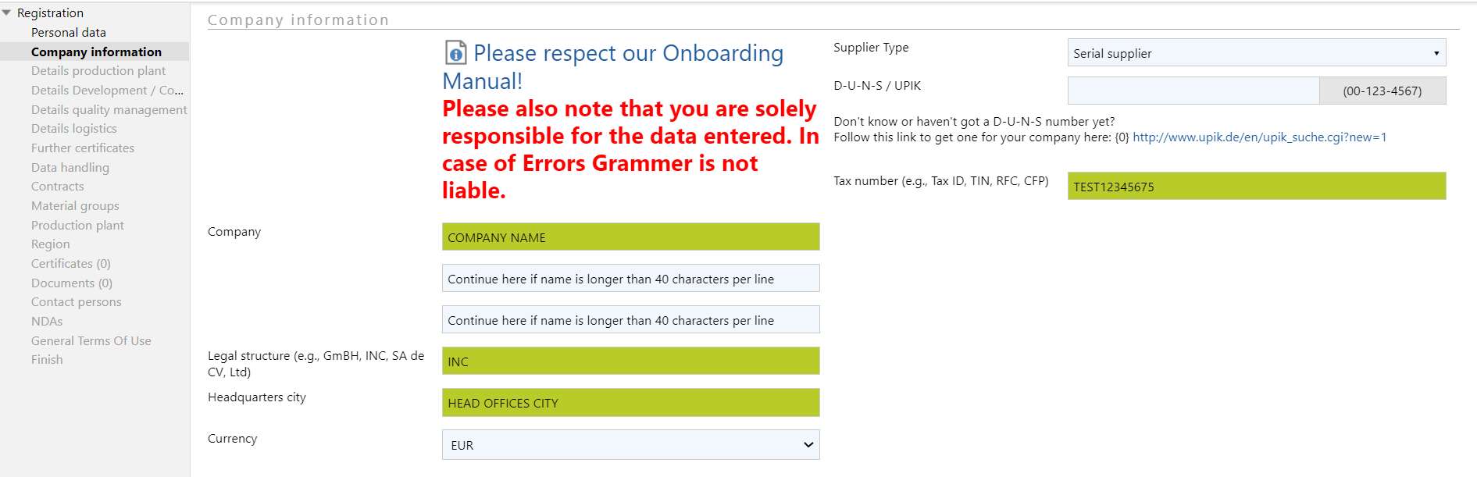
Company Information → Company Information
Please fill in your company information:
Link to the Onboarding Manual.
Decide whether you are a Serial or Non productive material supplier.
If you are located in Europe you have to fill in the D-U-N-S / UPIK
2
3
4

Slide 9
Company Information → Address
If you press this button, you will get to a list of all different regions per country.
Pay attention to the needed formats. (e.g., phone, mobile & fax numbers must match the format in the screenshot)
Please enter a general e-mail address (e.g., info@companyname.com) to which the orders / delivery schedules from all Grammer plants will be sent. The information must always be updated by you in a timely manner.
6
5
7

Slide 10
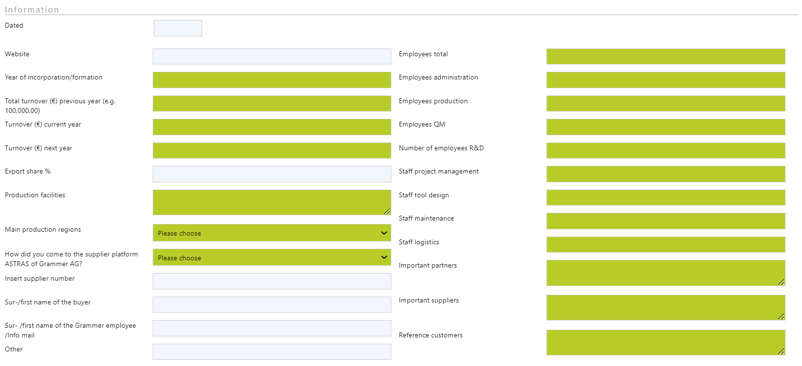
Company Information → Information
Your selection in this field will cause the corresponding field below it to be marked as mandatory.
8

Slide 11
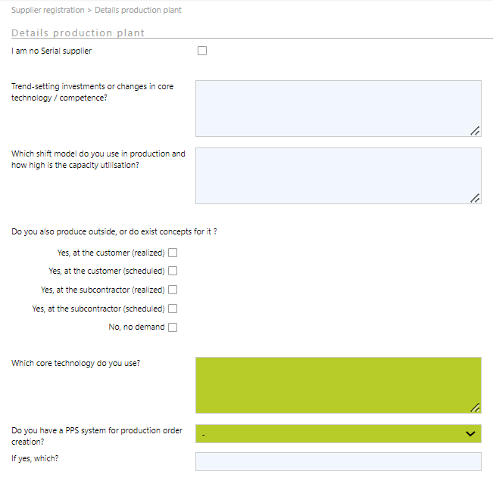
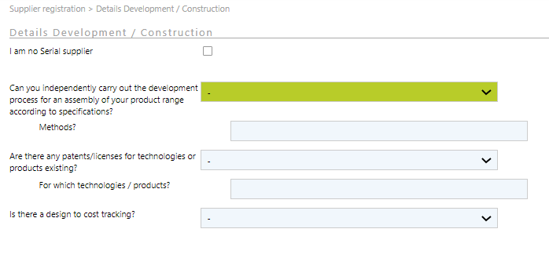
Supplier Registration → ¹Details Production Plant & ²Details Development / Construction
On each of the ⁴ "Details" tabs, select whether you are a serial supplier or not by checking the box.
Serial supplier: Please fill out these tabs completely.
Not a serial supplier (non-productive material): Mandatory fields will be updated to optional.
9
9
8
8
8

Slide 12
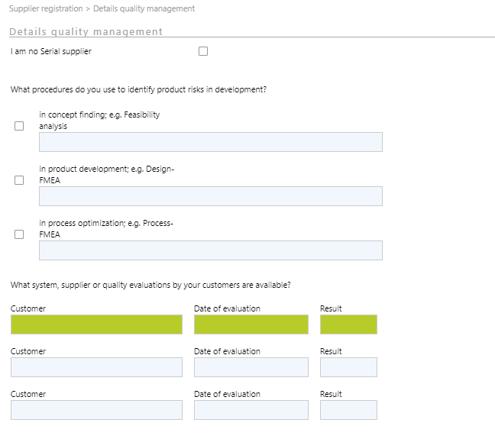
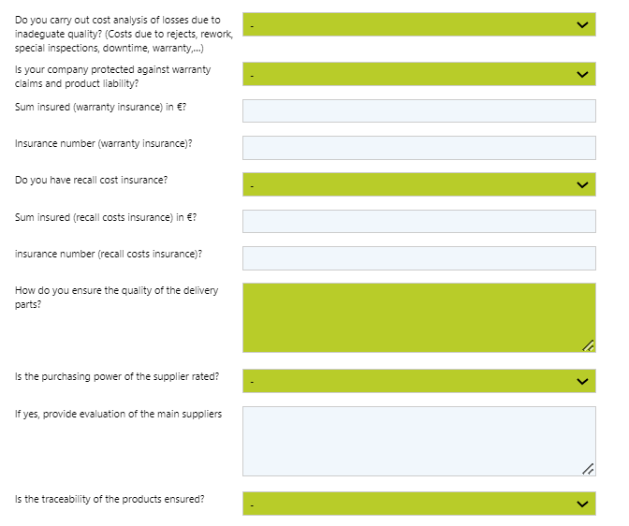
Supplier Registration → ³Details quality management
9
8
8
8

Slide 13
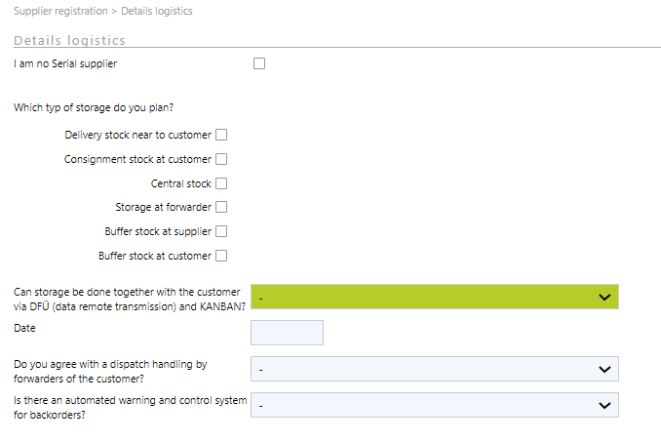
Supplier Registration → ⁴Details logistics
9

Slide 14
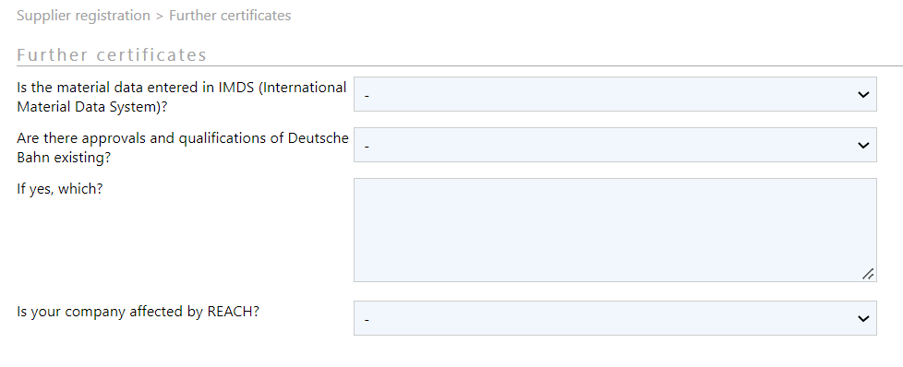
Supplier Registration → Further certificates
Serial supplier: Please fill out this tab completely.
Not a serial supplier (non-productive material): Fields are optional.

Slide 15
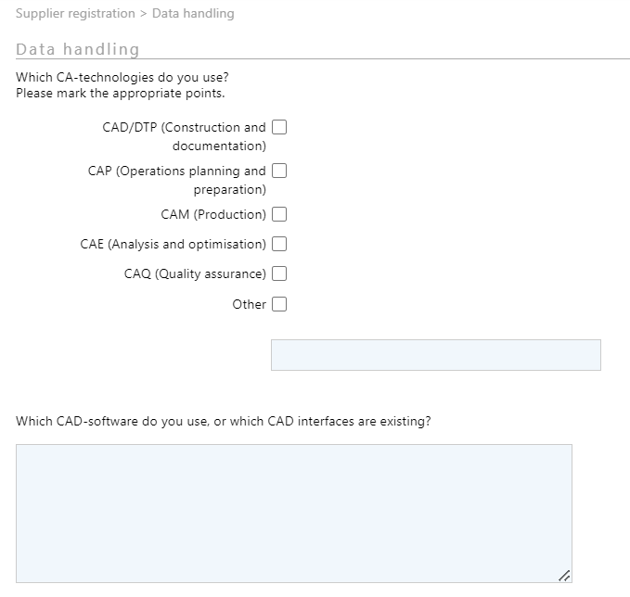
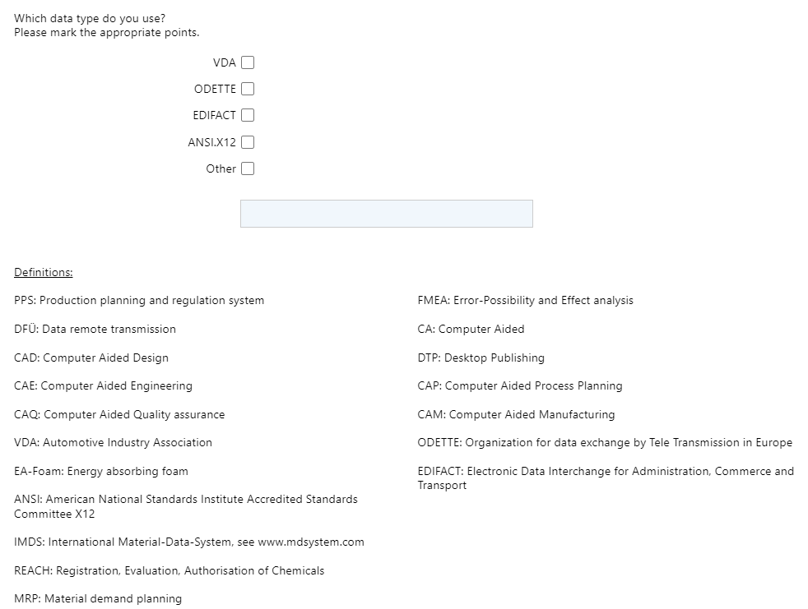
Supplier Registration → Data handling
Serial supplier: Please fill out this tab completely.
Not a serial supplier (non-productive material): Fields are optional.
The definitions for all abbreviations can be found in the lower part of the tab.
10

Slide 16
Supplier Registration → Contracts
Please accept the applicable Grammer contracts here.
Then upload the signed contracts under the "Documents" tab. Make sure you select the correct type of document (more details on slide 25).
11
12

Slide 17
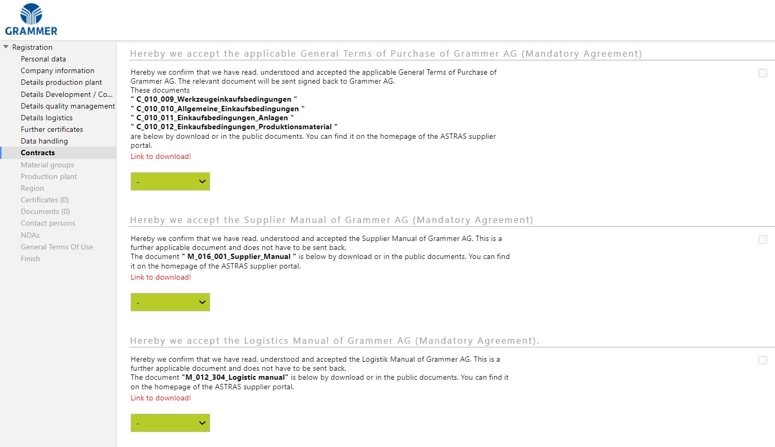
Supplier Registration → Contracts

Slide 18
Supplier Registration → Material Groups
13
13
Click here to add new material groups. After you have saved your registration, only your PU contact can assist you if you need to make changes.
Please select the material groups indicated in the email invitation you received and/or you can also add other types of products you mainly offer, but never more than 5 sub-products/areas.
Very important:
If your main product is a Series product (e.g., plastics, steel, foam, electronics) and you also offer services or packaging please DO NOT select these material groups. (Example: You supply not only plastic parts, but also the appropiate packaging -> Please select only Plastics.)
14

Slide 19
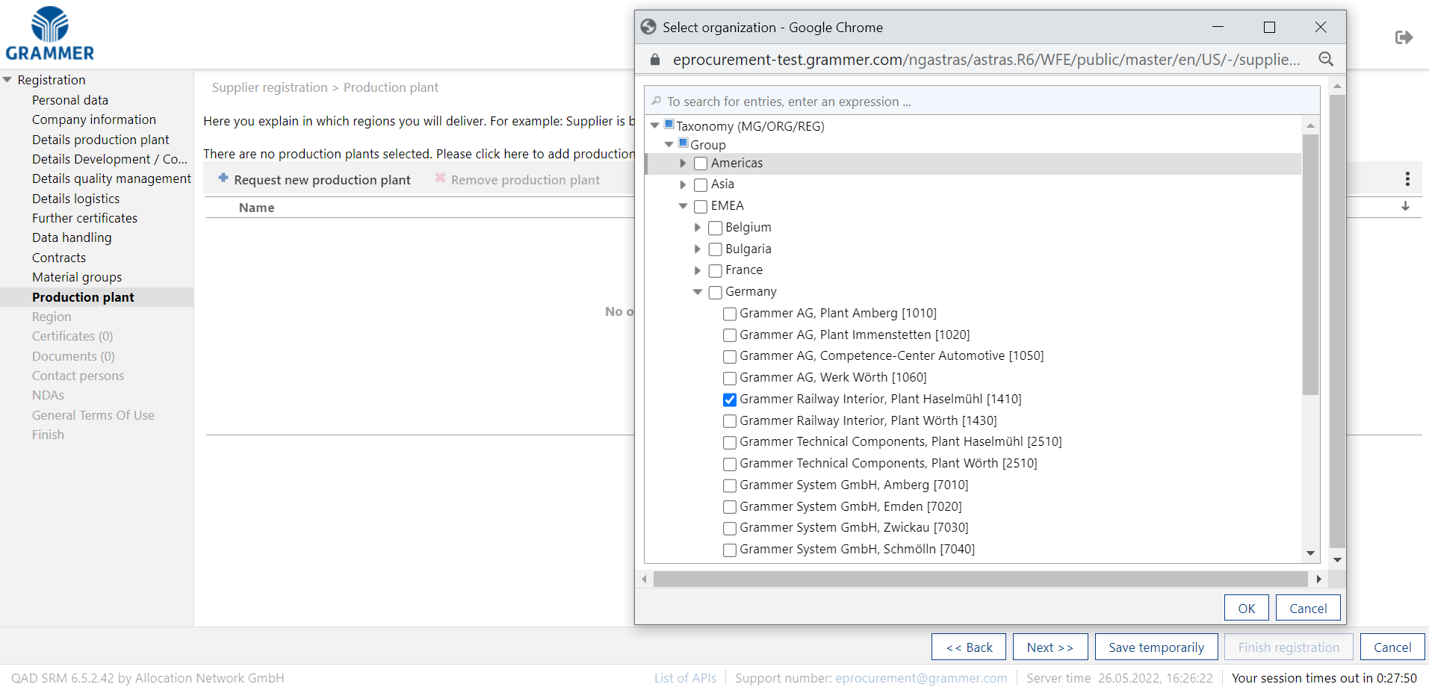
Supplier Registration → Production plant
Please select for which Grammer production facility you would like to submit a bid or for which you already supply.
Do not select a general region (e.g. EMEA), but search for specific production sites (e.g. Grammer AG, Amberg 1010 plant) or countries (e.g. Germany).
15

Slide 20
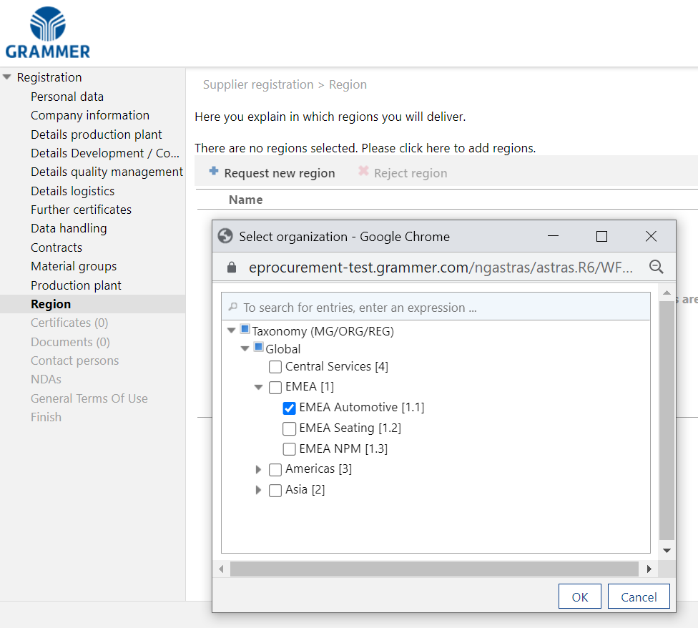
Supplier Registration → Region
Please select the region to which your company's country belongs. The respective industry (Automotive/Seating/NPM) may also have been specified in the invitation email sent to you.
16

Slide 21
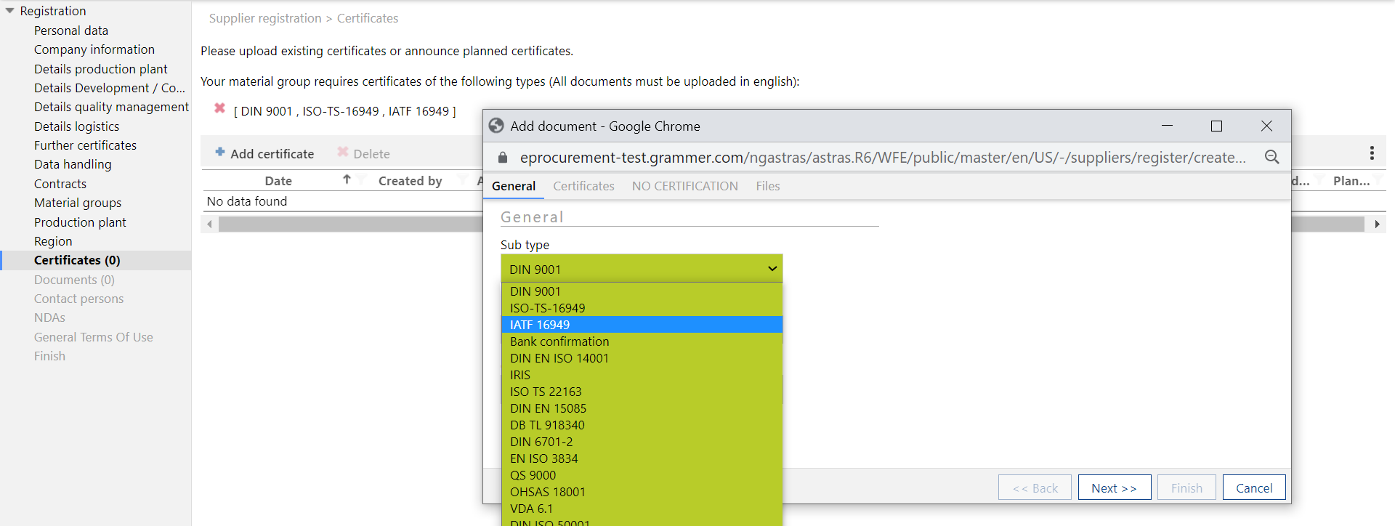
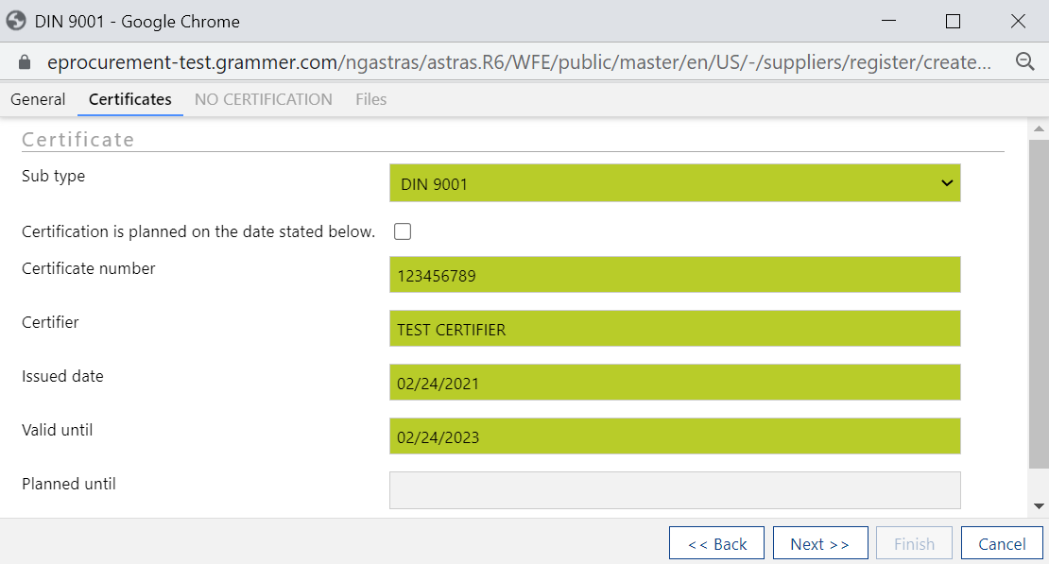
Supplier Registration → Certificates
Please upload your certificates on this tab (the process must be performed for each certificate individually):
As a series supplier, the upload of a DIN 9001, ISO-ts16949 or IATF 16949 is mandatory. Possession of other certificates is desired and has a positive effect on the supplier rating.
Make sure you select the right type of certificate so that the system considers the requirement fulfilled.
If you are in a certification process, you can click this checkbox and specify the scheduled date of certification. Your registration will be rechecked once the promised date is reached.
18
17

Slide 22
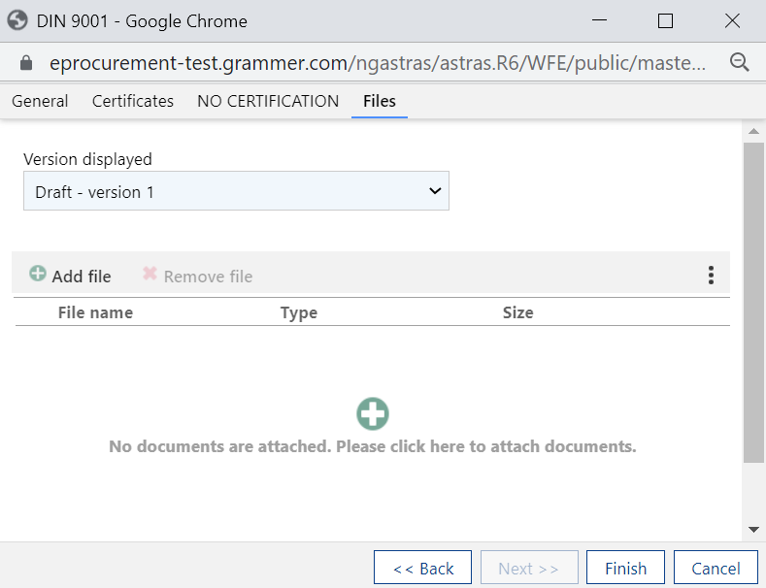
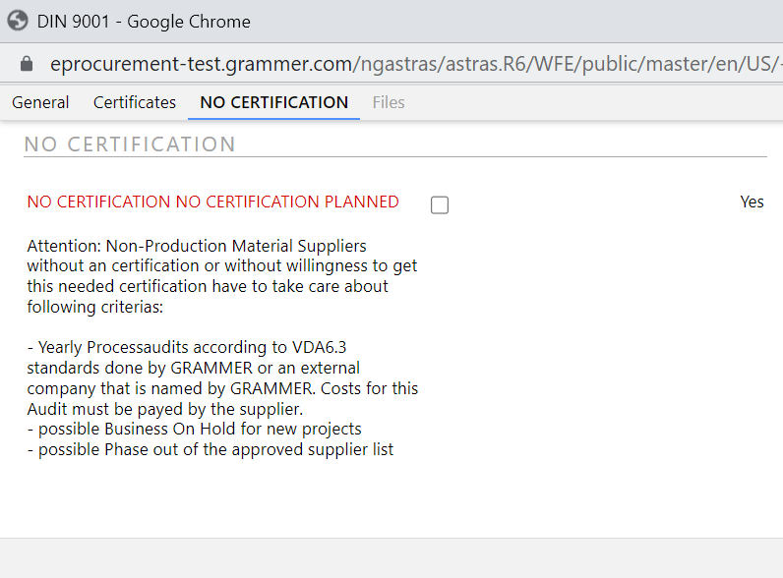
Supplier Registration → Certificates
Suppliers of non-production material are also recommended to have the basic certifications. If these are not available, please carefully read the requirements for this situation on the "NO CERTIFICATION" tab.
Upload your document here.
Finally click on “Finish”.
19
20
20
21

Slide 23
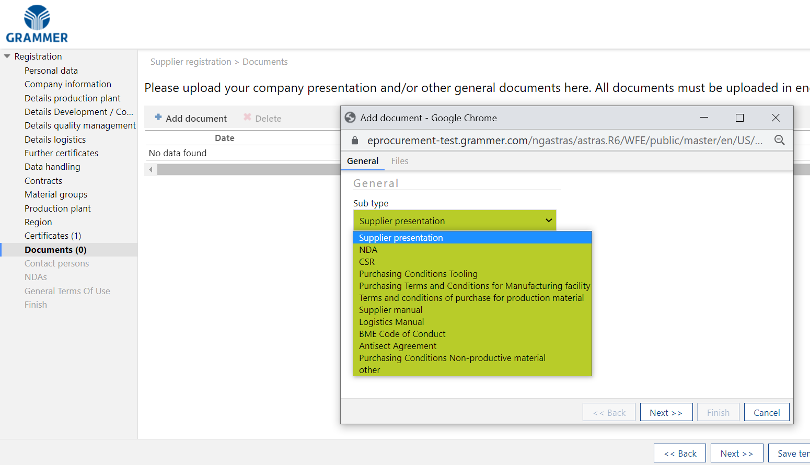
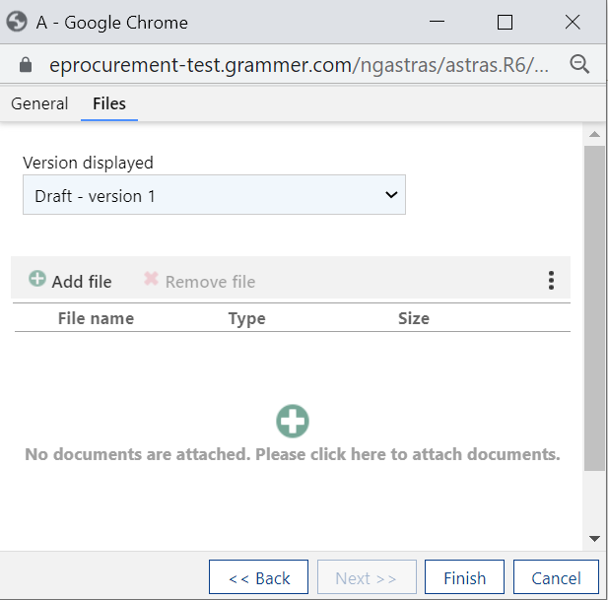
Supplier Registration → Documents
Please upload your contracts, company presentation, and any other documents you feel are important on this tab (the process must be performed for each document individually):
20
20
21

Slide 24
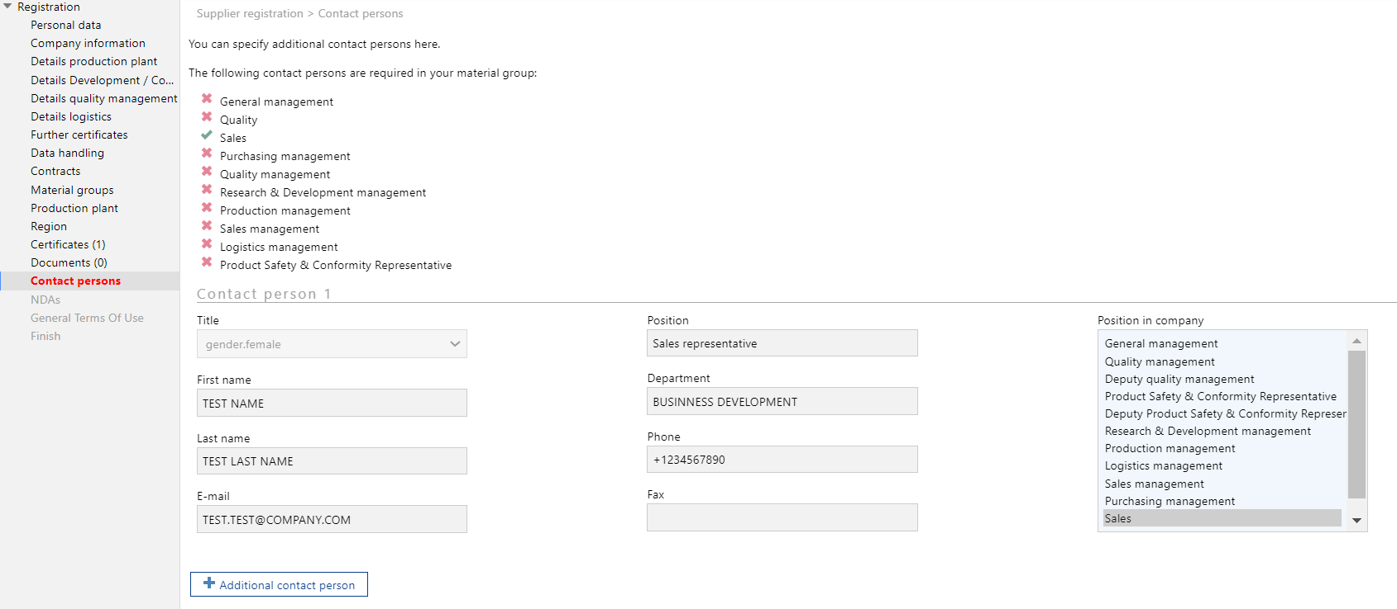
Supplier Registration → Contact persons
As a serial supplier, the specification of all these contact persons is mandatory.
To assign a contact person type, simply click on the corresponding position in the table on the right. When the selection matches one of the contacts required, the X will change to
Click this button to add the next contact.
22
23
24

Slide 25
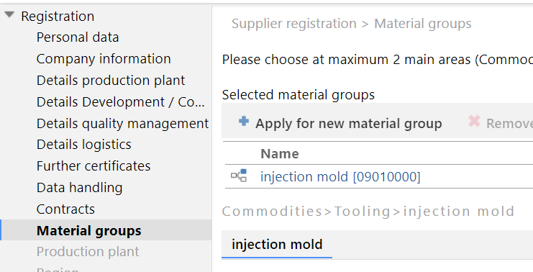
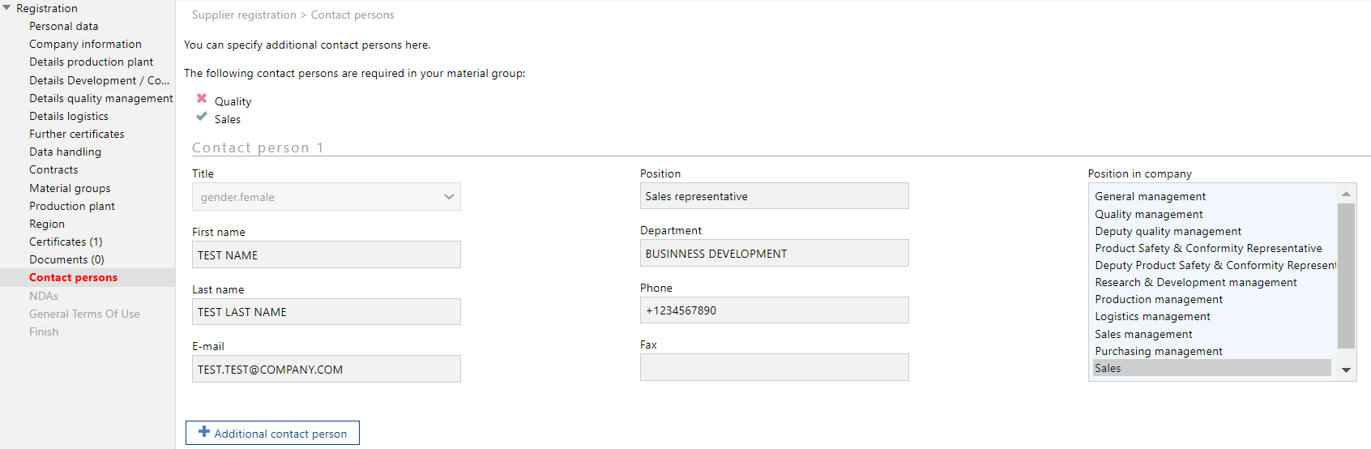
Supplier Registration → Contact persons (NPM)
The “Material Groups” tab will influence the mandatory contacts:
As an investment, services, logistics or packaging supplier, you only need to specify the contact persons for Sales and Quality. These material groups are reserved for non-productive material suppliers (e.g., Tooling supplier of Injection molds).

Slide 26
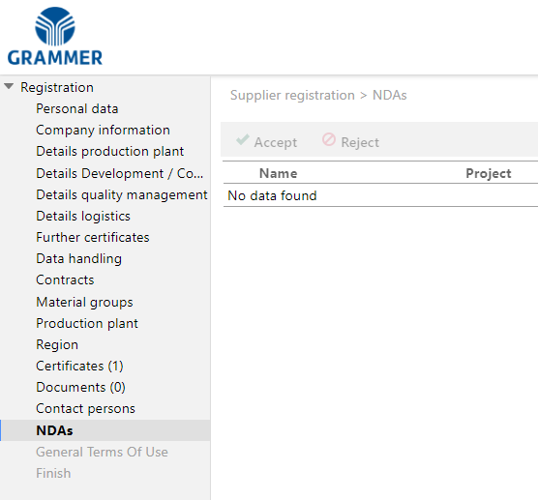
Supplier Registration → NDAs
No actions needed! Please skip this tab.

Slide 27
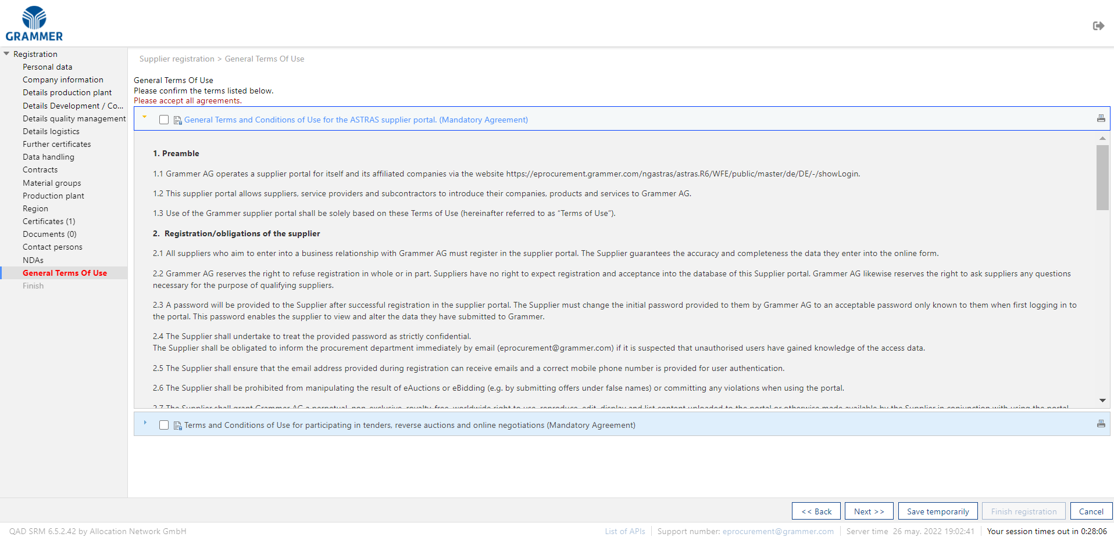
Supplier Registration → General Terms Of Use (ASTRAS)
Please confirm all documents related to the use of the system.
You can print the content here.
25
26
25
26

Slide 28
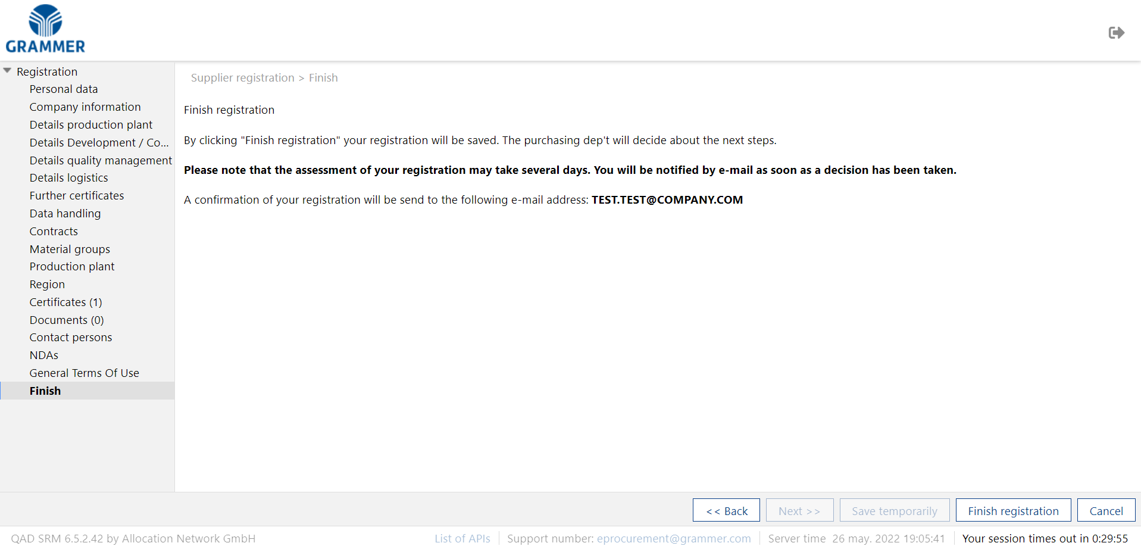
Finish
Supplier Registration → Finish
When all information and requirements are met, you may complete your registration by clicking on “FINISH REGISTRATION".
We ask you to wait until the internal approval procedures are completed. You will then receive a confirmation email with a username to access the system (the password is the one you created during registration).
26

Slide 29
Support contact
Operate@grammer.com

